Slide 1
Fridgify
A Smart Recipe Recommender Android Application
BU CS 501 Mobile Application
Team JK: Jingbo Wang, Chengkai Yang
Final Project Presentation
Dec 2024

Slide 2
Project Overview
App Name: Fridgify - Smart Recipe Recommender
Purpose:
Recommend recipes based on available ingredients
Provide detailed cooking instructions
Enable offline access to recipes and ingredients
Technologies Used:
Android (Kotlin, Jetpack Compose)
Firebase (Authentication, Realtime Database, Analytics, Cloud Messaging)
External APIs (FatSecret, OpenFoodFacts, Google Custom Search)
Room Database for local caching

Slide 3
Key Features:
Ingredient-Based Recipe Recommendations:
Users input available ingredients
App suggests suitable recipes
Barcode Scanning:
Scan barcode of an ingredient using device’s camera
Record the info of the product as input in ingredients
Personalized Preferences:
Favorite cuisines
Step-by-Step Instructions:
Detailed cooking steps for each recipe
Offline Functionality:
Cached data ensures accessibility without internet
Push Notifications:
Alerts for new recipes, expiring ingredients
Usage Analytics:
Tracks user interactions to refine recommendations

Slide 4
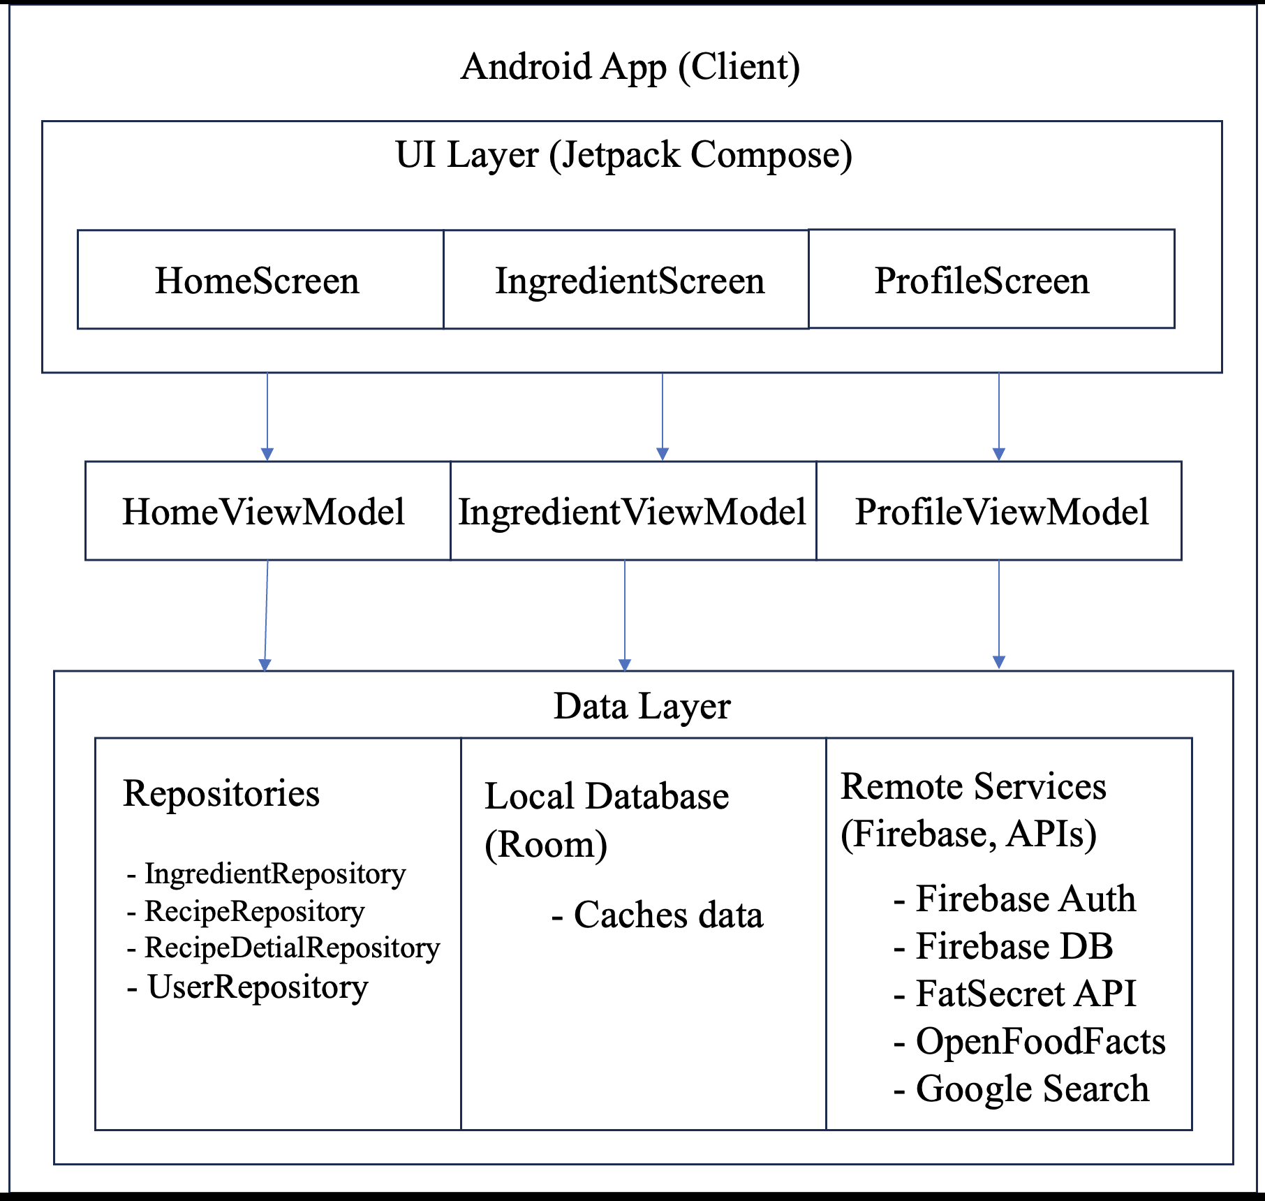
Technical Architecture:
MVVM Pattern:
Model: Data layer (Room, Firebase, External APIs)
View: UI layer (Jetpack Compose)
ViewModel: Manages UI-related data and business logic, interacts with Repositories
Navigation:
Jetpack Navigation component for screen transitions
Data Flow:
User interacts with UI → ViewModel processes data → Repositories handle data operations → Data sources (Room, Firebase, APIs)

Slide 5
User Authentication
Security Measures:
User Authentication:
Firebase Authentication for secure login/signup
Email verification to ensure valid users
Authorization:
Firebase Realtime Database Security Rules
Ensures users can only access their own data
Re-Authentication for Sensitive Operations:
Requires users to re-enter credentials for critical actions
Secure Communication:
All data transmission over HTTPS
Error Handling and Logging:
Firebase Crashlytics for real-time crash reporting
Secure logging practices to prevent data leaks

Slide 6
Challenges Faced
Data Synchronization:
Ensuring consistency between local Room database and Firebase
Handling External API Limitations:
Rate limiting and varying response times from FatSecret and OpenFoodFacts APIs
User Authentication Flow:
Managing re-authentication and email verification seamlessly
Performance Under Load:
Maintaining app responsiveness as user base and data volume grew
UI/UX Design:
Creating an intuitive and responsive interface with Jetpack Compose

Slide 7
Solutions Implemented
Two-Way Data Synchronization:
Implemented synchronization logic in repositories
Used WorkManager for background tasks
Caching and Throttling:
Cached external API responses in Room
Bounded the number of concurrent API calls to manage rate limits
Robust Authentication Flow:
Integrated Firebase Auth with re-authentication prompts for sensitive actions
Automated email verification handling
Optimized Data Handling:
Employed Kotlin Coroutines for efficient asynchronous processing
Utilized pagination and lazy loading for large data sets
Responsive UI Design:
Leveraged Jetpack Compose’s flexibility for dynamic layouts
Implemented animations and visual feedback for better user experience

Slide 8
Lessons Learned
Importance of Secure Authentication:
Early integration of Firebase Authentication streamlined security measures
Effective Caching Improves Performance:
Reducing network dependency enhances app responsiveness and user satisfaction
Handling API Limitations Requires Strategic Planning:
Implementing caching and request batching mitigated external API constraints
Continuous Monitoring is Crucial:
Utilizing Firebase Crashlytics and Analytics provided valuable insights for improvements
Iterative Development Enhances Quality:
Regular testing and feedback loops ensured the app meet user needs and performed reliably

Slide 9
Demo
Home Screen:
Displays recommended recipes based on ingredients
Ingredient Management:
Add, edit, and delete ingredients with smooth animations
Recipe Detail View:
Detailed instructions and nutritional information
Authentication Flow:
Secure sign-in, sign-up, and email verification processes
Offline Access:
Access cached recipes and ingredients without internet
Push Notifications:
Receive alerts for new recipes and expiring ingredients

Slide 10
Future Enhancements
Advanced Dietary Filters:
More granular filters for specific dietary needs
Machine Learning Integration:
Personalized recipe recommendations based on user behavior
Social Features:
Enable users to share recipes and interact within the app
Enhanced Notifications:
Context-aware notifications for better user engagement
Expanded API Integrations:
Incorporate additional data sources for richer recipe information

Slide 11
Conclusion
Fridgify effectively addresses the need for personalized, ingredient-based recipe recommendations
Successful integration of secure authentication, efficient data handling, and a user-friendly interface
Overcame significant challenges through strategic solutions and continuous learning
Laid a solid foundation for future growth and feature expansion

Slide 12

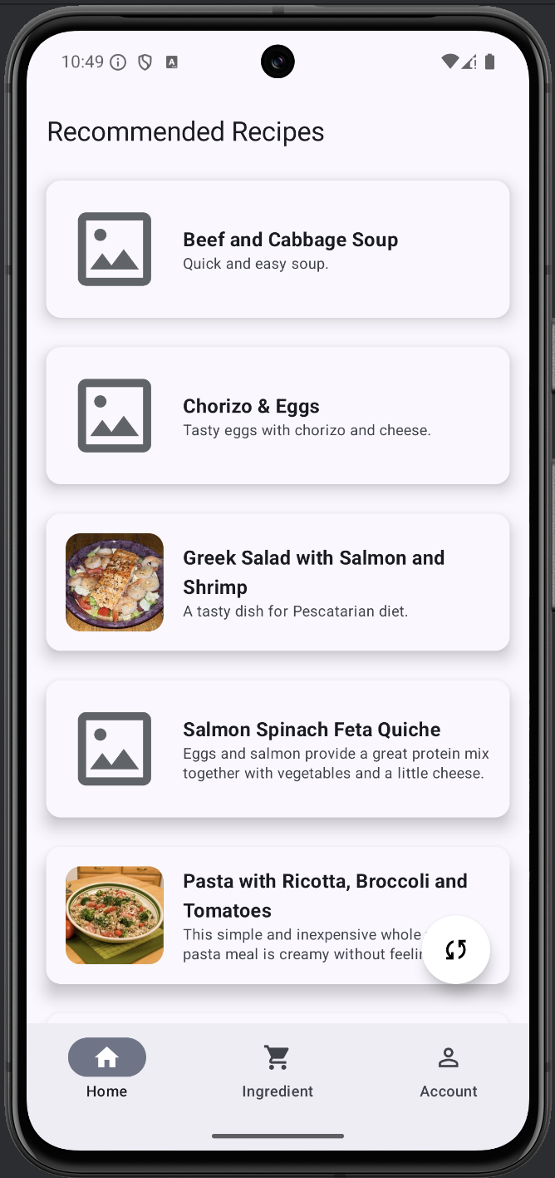
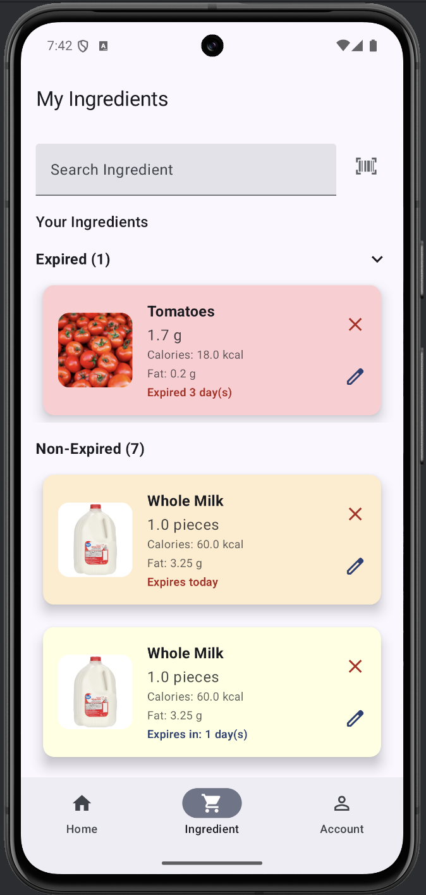
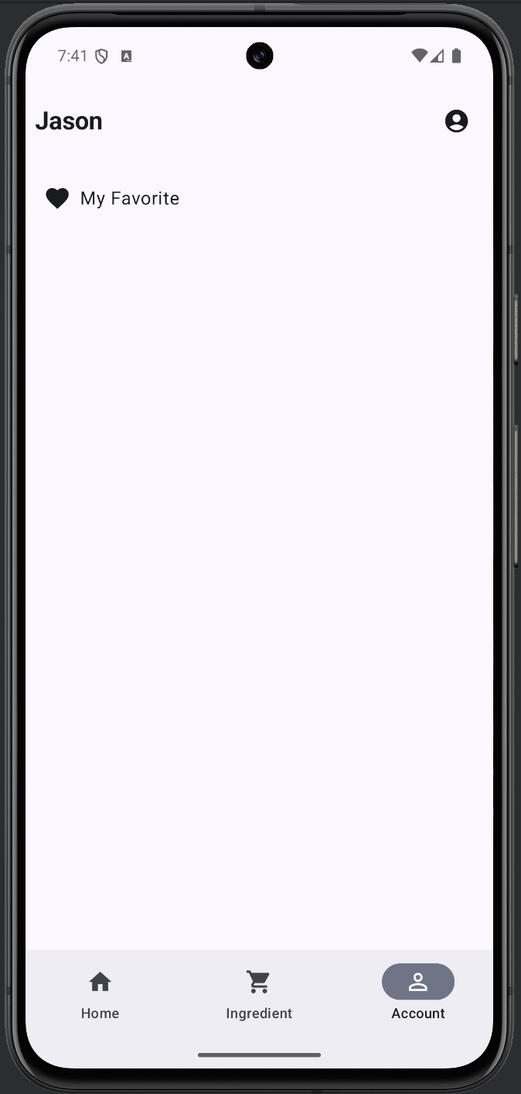

Slide 13

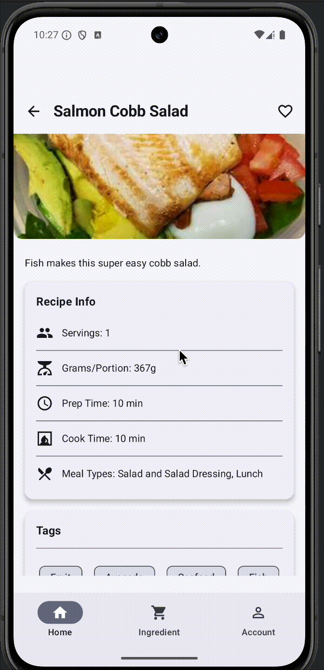
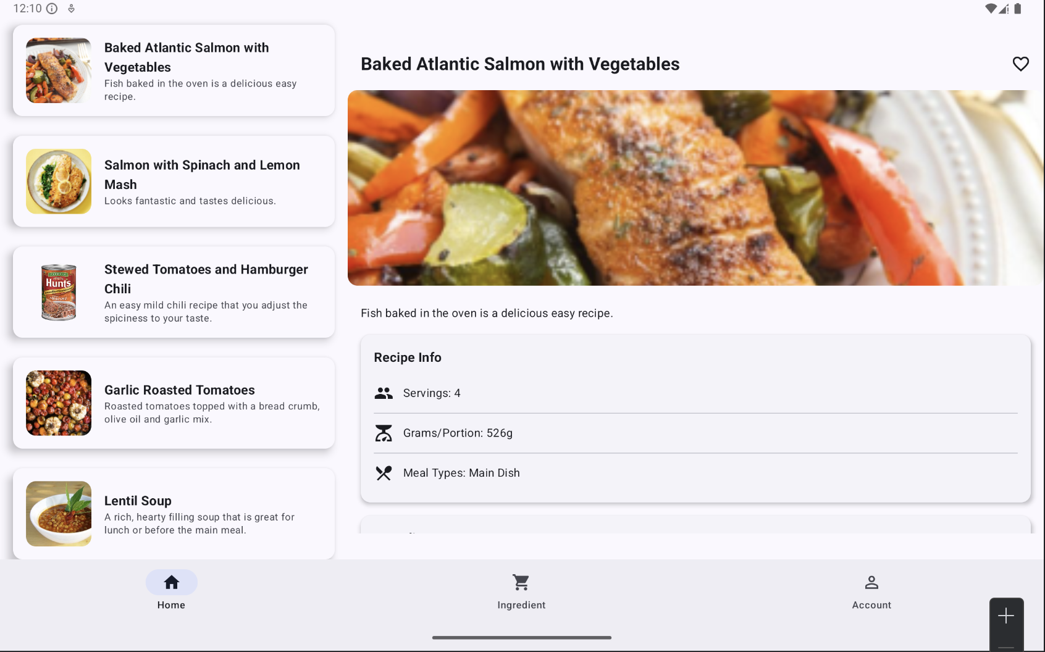

Slide 14
Q&A
Any questions?

Slide 15

Thank You!

